Slide 1
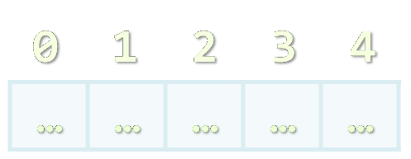

Arrays
Processing Sequences of Elements
Doncho Minkov
Senior Technical Trainer
http://minkov.it
Telerik Software Academy
http://academy.telerik.com

Slide 2

Table of Contents
Declaring and Creating Arrays
Accessing Array Elements
Processing Array Elements
Dynamic Arrays
Sorting Arrays

Slide 3


Declaring and Creating Arrays

Slide 4
What are Arrays?
An array is a sequence of elements
The order of the elements is fixed
Does not have fixed size
Can get the current length (Array.length)
Element of an array
0 1 2 3 4
Element index
Array of 5 elements
… | … | … | … | …

Slide 5
Declaring Arrays
Declaring an array in JavaScript (JS is typeless)
// Array holding integers
var numbers = [1, 2, 3, 4, 5];
// Array holding strings
var weekDays = ["Monday", "Tuesday", "Wednesday",
"Thursday", "Friday", "Saturday", "Sunday"]
// Array of different types
var mixedArr = [1, new Date(), "hello"];
// Array of arrays (matrix)
var matrix = [
["0,0", "0,1", "0,2"],
["1,0", "1,1", "1,2"],
["2,0", "2,1", "2,2"]];

Slide 6

Declare and Initialize Arrays
Initializing an array in JavaScript can be done in three ways:
Using new Array(elements):
Using new Array(initialLength):
Using array literal (recommended):
var arr = new Array(1, 2, 3, 4, 5);
var arr = new Array(10);
var arr = [1, 2, 3, 4, 5];

Slide 7

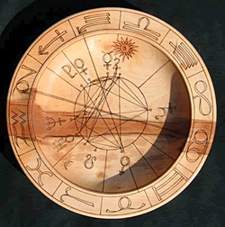
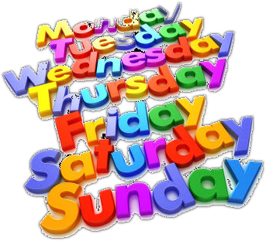
Creating Arrays
Live Demo

Slide 8

Accessing Array Elements
Read and Modify Elements by Index

Slide 9
How to Access Array Element?
Array elements are accessed using the square brackets operator [] (indexer)
Array indexer takes element’s index as parameter in the range 0 … length-1
The first element has index 0
The last element has index length-1
Array elements can be retrieved and changed by the [] operator

Slide 10
Reversing an Array – Example
Reversing the elements of an array
var array = [1, 2, 3, 4, 5];
// Get array size
var length = array.length; // 5
// Declare and create the reversed array
var reversed = new Array(length);
// Initialize the reversed array
for (var index = 0; index < length; index++) {
reversed[length-index-1] = array[index];
}

Slide 11
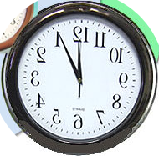

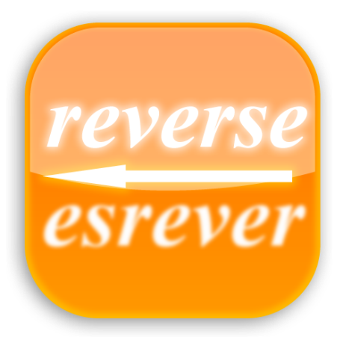
Reversing an Array
Live Demo

Slide 12
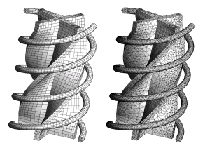
Processing Array Elements Using for and for-in

Slide 13
Processing Arrays: for Statement
Use for loop to process an array when
Need to keep track of the index
In the loop body use the element at the loop index (array[index]):
for (var index = 0; index < array.length; index++)
{
squares[index] = array[index] * array[index];
}

Slide 14
Processing Arrays Using for Loop – Examples
Printing array of integers in reversed order:
Initialize all array elements with their corresponding index number:
var array = [1, 2, 3, 4, 5];
for (var i = array.length-1; i >= 0; i--) {
console.log(array[i]);
}
// Result: 5 4 3 2 1
for (var index = 0; index < array.length; index++) {
array[index] = index;
}

Slide 15
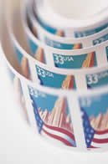
Processing Arrays: for-in
How for-in loop works?
i iterates through all the indexes of array
Used when the indexes are unknown
All elements are accessed one by one
Order is not guaranteed
for (var i in array)

Slide 16
Example: Processing Arrays Using for-in Loop
Print all elements of an array of strings:
var capitals =[
"Sofia",
"Washington",
"London",
"Paris"
];
for (var i in capitals)
{
console.log(capitals[i]);
}

Slide 17
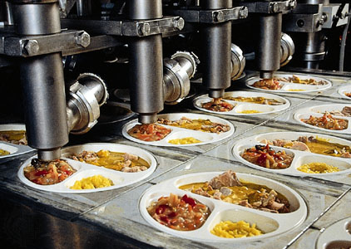
Processing Arrays
Live Demo

Slide 18
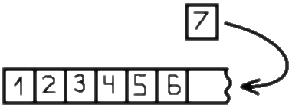

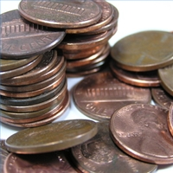
Dynamic Arrays

Slide 19
Dynamic Arrays
All arrays in JavaScript are dynamic
Their size can be changed at runtime
New elements can be inserted to the array
Elements can be removed from the array
Methods for array manipulation:
array.push(element)
Inserts a new element at the tail of the array
array.pop()
Removes the element at the tail
Returns the removed element

Slide 20
Dynamic Arrays (2)
Methods for array manipulation (cont.)
array.unshift(element)
Inserts a new element at the head of the array
array.shift()
Removes and returns the element at the head
var numbers = [1, 2, 3, 4, 5];
console.log(numbers.join("|")); // result: 1|2|3|4|5
var tail = number.pop(); // tail = 5;
console.log(numbers.join("|")); // result: 1|2|3|4
number.unshift(0);
console.log(numbers.join("|")); // result: 0|1|2|3|4
var head = number.shift(); // head = 0;
console.log(numbers.join("|")); // result: 1|2|3|4

Slide 21
Dynamic Arrays
Live Demo

Slide 22
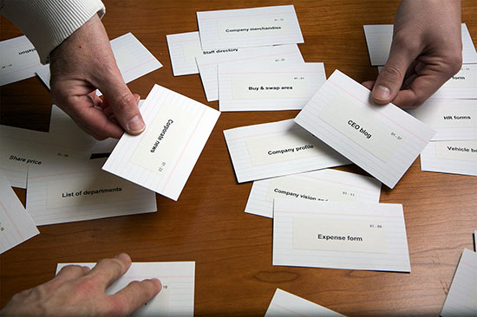
Sorting Arrays
Array.sort() and Array.sort(orderBy)

Slide 23
Sorting Arrays
array.sort()
Sorts the elements of the array ascending
Keep in mind that array.sort uses the string representation of the elements!
i.e. the number 5 is compares as the string "5"
Not quite sorted, right?
var numbers = [5, 4, 2, 3, 1, 4, 5, 6, 7];
numbers.sort();
console.log(numbers.join(", "));
// result: 1, 2, 3, 4, 4, 5, 5, 6, 7
var numbers = [5,4,23,2];
numbers.sort();
console.log(numbers.join(", ")); // result: 2, 23, 4, 5

Slide 24
Sorting Arrays with Compare Function
array.sort(compareFunc)
Sorts element using a compare function
The compare function defines the sorting rules
Return negative or 0 to leave the elements
Return positive to swap them
function orderBy(a, b) {
return (a == b) ? 0 : (a>b) ? 1 : -1;
};
var numbers = [5, 4, 23, 2];
numbers.sort(orderBy);
console.log(numbers.join(", "));
// returns 2, 4, 5, 23

Slide 25
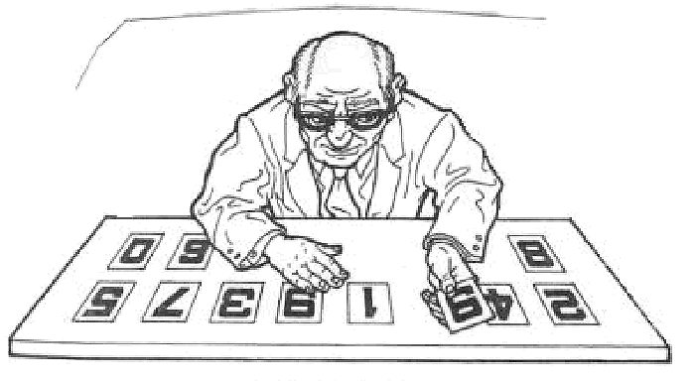
Sorting Arrays
Live Demo

Slide 26
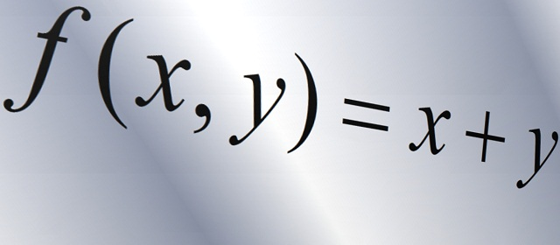
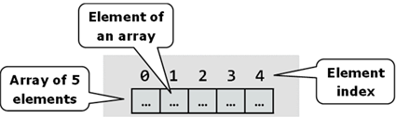
Other Array Functions

Slide 27
Other Array Functions
array.reverse()
Returns a new arrays with elements in reversed order
array.splice(index, count, elements)
Adds and / or removes elements from an array
array.concat(elements)
Inserts the elements at the end of the array and returns a new array
array.join(separator)
Concatenates the elements of the array

Slide 28
Other Array Functions (2)
array.filter(condition)
Returns a new array with the elements that satisfy condition
array.forEach(function(item){})
Iterates through the array and executes the function for each item

Slide 29
Other Functions
Live Demo

Slide 30
Other Array Functions (2)
array.indexOf(element)
Returns the index of the first match in the array
Returns -1 is the element is not found
array.lastIndexOf(element)
Returns the index of the first match in the array
Returns -1 is the element is not found
indexOf() and lastIndexOf() do not work in all browsers
Need to add a predefined functionality

Slide 31
indexOf() and lastIndexOf()
Live Demo

Slide 32
Other Arrays Functions
Arrays official documentation:
https://developer.mozilla.org/en-US/docs/Web/JavaScript/Reference/Global_Objects/Array
Checking for array
typeof([1,2,3]) → object
Array.isArray([1,2,3]) → true
Supported on all modern browsers

Slide 33

Arrays
http://academy.telerik.com

Slide 34
Exercises
Write a script that allocates array of 20 integers and initializes each element by its index multiplied by 5. Print the obtained array on the console.
Write a script that compares two char arrays lexicographically (letter by letter).
Write a script that finds the maximal sequence of equal elements in an array.
Example: {2, 1, 1, 2, 3, 3, 2, 2, 2, 1} → {2, 2, 2}.

Slide 35
Exercises (2)
Write a script that finds the maximal increasing sequence in an array. Example: {3, 2, 3, 4, 2, 2, 4} → {2, 3, 4}.
Sorting an array means to arrange its elements in increasing order. Write a script to sort an array. Use the "selection sort" algorithm: Find the smallest element, move it at the first position, find the smallest from the rest, move it at the second position, etc. Hint: Use a second array
Write a program that finds the most frequent number in an array. Example:
{4, 1, 1, 4, 2, 3, 4, 4, 1, 2, 4, 9, 3} → 4 (5 times)

Slide 36
Exercises (3)
Write a program that finds the index of given element in a sorted array of integers by using the binary search algorithm (find it in Wikipedia).

